Slide 1


LECTURE 3
Linear
classification
Foundations of Artificial Intelligence
SEMTM0051 · 2026/27
Lecturer: Dr Roberto Colomboni
Notes:
Binary classification with one input, gradient descent, and extensions to several features and classes. Based on the supplied Lecture 3 notes.

Slide 2
Today's lecture
Binary classification
Classification error and logistic loss
Gradient descent
More than two classes
Foundations of AI · Lecture 3
2
Notes:
Pacing: 0.75 min. Suggested elapsed time 0.25–1 min.
Use the highlighted topic to locate this part of the lecture.
Reference: Lecture 3, Linear classification, notes version 27 September 2026 (SEMTM0051_week3_classification (13).tex). The planar numerical examples use the synthetic dataset Week_03_classification_distinct.csv, with eta=0.001.

Slide 3
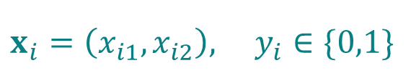
Binary classification
A synthetic dataset: 100 observations, two input features and two classes.
$$x_{i}=\left(x_{i1},x_{i2}\right), y_{i}∈\{0,1\}$$
x₁: first input feature
x₂: second input feature
Class 0: 50 observations
Class 1: 50 observations
Learn a rule to predict
the class of an input.
A modified Iris dataset: 100 observations, two features and two classes.
Dataset and instructions in the folder: Week 3 - Examples
Foundations of AI · Lecture 3
3
Notes:
This is a synthetic teaching dataset with 100 observations and 50 labels in each class. x1 and x2 are numerical input features without physical units. Each observation has a distinct coordinate pair. The CSV Week_03_classification_distinct.csv gives the exact coordinates used in every planar plot, error count and gradient descent calculation. The layout is adapted from the earlier two-feature Iris illustration by changing the coordinates to separate observations. These are synthetic coordinates, not original flower measurements. The labels here are generic class 0 and class 1. Keep the CSV in the same folder as the presentation to use the link. Underlying source layout: Fisher, R. (1936), Iris, UCI Machine Learning Repository, https://doi.org/10.24432/C56C76, CC BY 4.0 https://creativecommons.org/licenses/by/4.0/ .

Slide 4



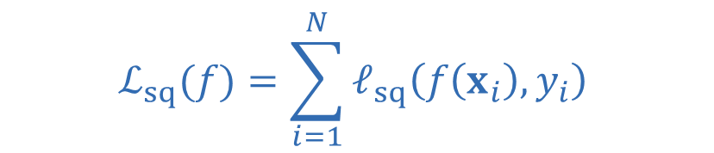
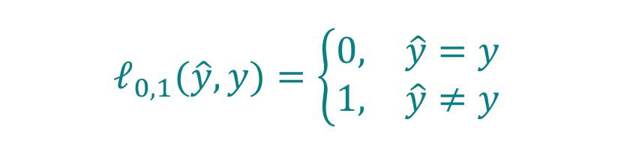

Measuring classification error
A regression predictor $f$
returns a number
A classifier $h$
returns a class label.
Regression
Classification
$$ℓ_{sq}\left(\hat{y},y\right)={\left(\hat{y}−y\right)}^{2}$$
$$ℓ_{0,1}(\hat{y},y)=\left\{\begin{matrix}0, & \hat{y}=y \\ 1, & \hat{y}≠y\end{matrix}\right.$$
Empirical squared loss
Number of mistakes
$$ℒ_{sq}(f)=\sum_{i=1}^{N}{ℓ_{sq}\left(f\left(x_{i}\right),y_{i}\right)}$$
$$ℰ(h)=\sum_{i=1}^{N}{ℓ_{0,1}}\left(h\left(x_{i}\right),y_{i}\right)$$
Larger numerical errors
receive larger penalties
All mistakes are penalized
the same way
Foundations of AI · Lecture 3
4
Notes:
Pacing: 1.5 min. Suggested elapsed time 2–3.5 min.
Recall squared loss in regression: it compares numerical values. Here labels are names, and a wrong label costs one. Define h as the classifier and hat y as its predicted label. Lowercase ell is one loss; E is its sum. The sum counts mistakes, and dividing by N gives the error rate. Fitting performance is distinct from performance on new observations.
Reference: Lecture 3, Linear classification, notes version 27 September 2026 (SEMTM0051_week3_classification (13).tex). The planar numerical examples use the synthetic dataset Week_03_classification_distinct.csv, with eta=0.001.

Slide 5



Predicting a probability first
A label gives a decision.
A probability also records how strongly the model favours that label.
$$p:ℝ^{d}⟶[0,1]$$
Probability of class 1
Probability of class 0
$$p\left(x\right)$$
$$1−p\left(x\right)$$
Example: if $p\left(x\right)=0.51$ we think that there is
- a $0.51$ probability that the correct class of input $x$ is $1$
- a $0.49$ probability that the correct class of input $x$ is $0$
If we must choose one label, which should we predict?
Foundations of AI · Lecture 3
5
Notes:
Pacing: 0.75 min. Suggested elapsed time 3.5–4.25 min.
Call p a probability function or probability predictor. These are probabilities assigned by a model, not probabilities already known to be correct. For equal mistake costs, the natural decision is the more probable label. This introduces the plug-in rule before choosing a parametric probability model.
Reference: Lecture 3, Linear classification, notes version 27 September 2026 (SEMTM0051_week3_classification (13).tex). The planar numerical examples use the synthetic dataset Week_03_classification_distinct.csv, with eta=0.001.

Slide 6
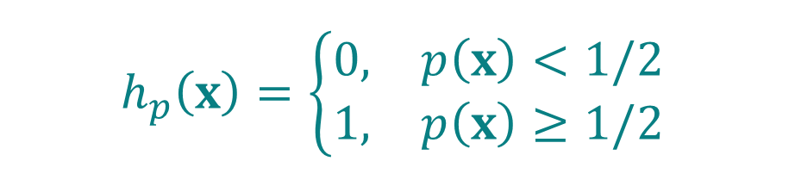

The plug-in classification rule
Choose the label with the larger probability. At a tie, we choose class 1.
$$h_{p}\left(x\right)=\left\{\begin{matrix}0, & p\left(x\right)<1/2 \\ 1, & p\left(x\right)≥1/2\end{matrix}\right.$$
Heaviside step function
$$step\left(s\right)≔\left\{\begin{matrix}0, & s<0, \\ 1, & s≥0.\end{matrix}\right.$$
$$h_{p}(x)=step\left(p(x)−\frac{1}{2}\right)$$
How do we choose the probability function?
Foundations of AI · Lecture 3
6
Notes:
Pacing: 1.25 min. Suggested elapsed time 4.25–5.5 min.
Define the step function before its shorthand is used. At probability one half the argument to step is zero and the result is one. Do not write step(p): the probability threshold requires p minus one half. Transition back to the affine construction from regression.
Reference: Lecture 3, Linear classification, notes version 27 September 2026 (SEMTM0051_week3_classification (13).tex). The planar numerical examples use the synthetic dataset Week_03_classification_distinct.csv, with eta=0.001.

Slide 7

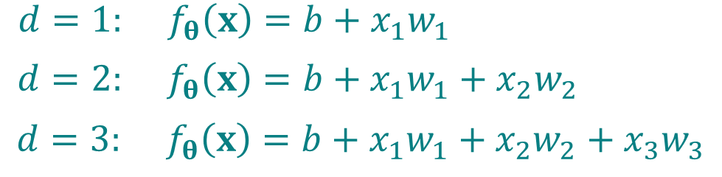
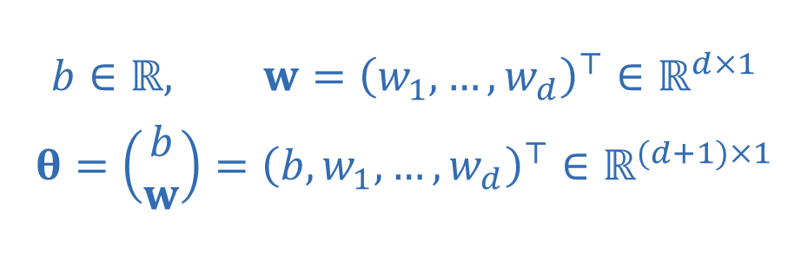
How do we build probability predictions?
Regression suggests using an intercept and one weight for each input feature.
$$f_{θ}\left(x\right)=b+xw=b+\sum_{j=1}^{d}{x_{j}w_{j}}$$
$$b∈ℝ, w={\left(w_{1},…,w_{d}\right)}^{⊤}∈ℝ^{d×1}$$
$$θ=\left(\begin{matrix}b \\ w\end{matrix}\right)={\left(b,w_{1},…,w_{d}\right)}^{⊤}∈ℝ^{(d+1)×1}$$
$$d=1: f_{θ}\left(x\right)=b+x_{1}w_{1}$$
$d=2: f_{θ}\left(x\right)=b+x_{1}w_{1}+x_{2}w_{2}$
$$d=3: f_{θ}\left(x\right)=b+x_{1}w_{1}+x_{2}w_{2}+x_{3}w_{3}$$
The score is also called a logit.
However, the score can be any real number!
It cannot serve directly as a probability.
Foundations of AI · Lecture 3
7
Notes:
Pacing: 1 min. Suggested elapsed time 5.5–6.5 min.
Input x is a row and weight w a column. Theta contains b first. In the plane theta=(b,w1,w2)^T. Unlike the regression output, this affine value is now an intermediate SCORE. We need a map from real scores to probabilities.
Reference: Lecture 3, Linear classification, notes version 27 September 2026 (SEMTM0051_week3_classification (13).tex). The planar numerical examples use the synthetic dataset Week_03_classification_distinct.csv, with eta=0.001.

Slide 8
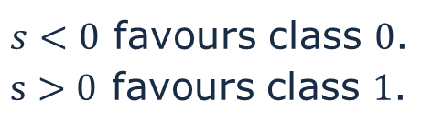


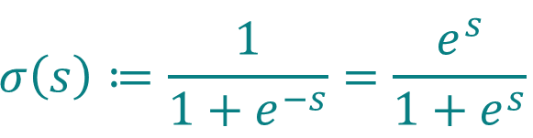
The sigmoid function
A smooth, increasing function turns each real score into a number between zero and one.
$$σ\left(s\right)≔\frac{1}{1+e^{−s}}=\frac{e^{s}}{1+e^{s}}$$
$$0<σ(s)<1$$
$$σ(0)=\frac{1}{2}$$
$s<0$ favours class $0$.
$s>0$ favours class $1$.
Foundations of AI · Lecture 3
8
Notes:
Pacing: 1.25 min. Suggested elapsed time 6.5–7.75 min.
Name s as a score, sigma as the logistic sigmoid. Every finite score produces a probability strictly inside (0,1). Point to sigma(0)=1/2, which will locate the decision boundary. This is a modelling choice that pairs conveniently with logistic loss.
Reference: Lecture 3, Linear classification, notes version 27 September 2026 (SEMTM0051_week3_classification (13).tex). The planar numerical examples use the synthetic dataset Week_03_classification_distinct.csv, with eta=0.001.

Slide 9
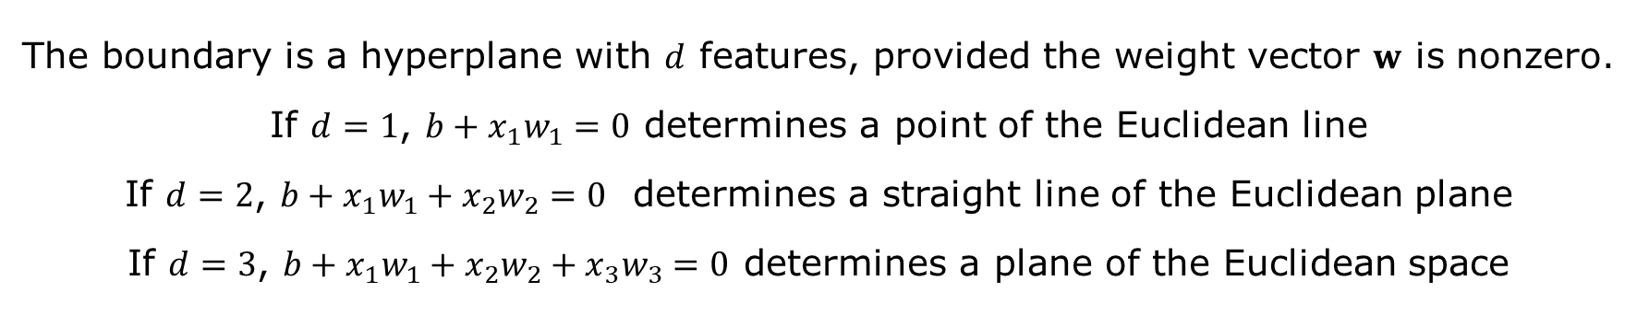
Probabilities, labels and the boundary
The sigmoid is increasing and maps score zero to probability one half.
$$p_{θ}\left(x\right)=σ\left(f_{θ}\left(x\right)\right)=σ(b+xw)$$
$$h_{p_{θ}}\left(x\right)=1 ⟺ p_{θ}\left(x\right)≥\frac{1}{2} ⟺ f_{θ}\left(x\right)≥0 ⟺ b+xw≥0$$
$$Separating hyperplane: b+xw=0$$
The boundary is a hyperplane with $d$ features, provided the weight vector $w$ is nonzero.
If $d=1$, $b+x_{1}w_{1}=0$ determines a point of the Euclidean line
If $d=2$, $b+x_{1}w_{1}+x_{2}w_{2}=0$ determines a straight line of the Euclidean plane
If $d=3$, $b+x_{1}w_{1}+x_{2}w_{2}+x_{3}w_{3}=0$ determines a plane of the Euclidean space
Foundations of AI · Lecture 3
9
Notes:
Pacing: 1.25 min. Suggested elapsed time 7.75–9 min.
Reconstruct the model orally: affine score, sigmoid probability, plug-in class label. The middle equivalence uses the tie rule and monotonicity. The bottom equality is the boundary in two input dimensions. On the boundary predict class 1. If every weight is zero, the classifier is constant. The probability itself is not affine.
Reference: Lecture 3, Linear classification, notes version 27 September 2026 (SEMTM0051_week3_classification (13).tex). The planar numerical examples use the synthetic dataset Week_03_classification_distinct.csv, with eta=0.001.

Slide 10


Comparing two candidate boundaries
The same observations can receive different labels when we change the parameters.
Class 1
Class 1
Class 0
Class 0
$$x_{2}=5.75$$
$$x_{2}=0.6x_{1}+1$$
The classifier on the right makes fewer mistakes on these observations
Foundations of AI · Lecture 3
10
Notes:
Compare two hand-chosen classifiers on Week_03_classification_distinct.csv. Class1 is predicted on and above the line, class0 below. Candidate A has theta=(-5.75,0,1), x2=5.75 and 31 mistakes. Candidate B has theta=(-1,-0.6,1), x2=0.6*x1+1 and 9 mistakes. Both plots show the same100 synthetic observations on fixed axes. These are not claimed optimal. We start gradient descent from A later.

Slide 11


Finding the parameters
We want the smallest mistake count.
Finding the parameter $θ^{∗}$ that minimizes
$$θ⟼ℰ(θ)=\sum_{i=1}^{N}{ℓ_{0,1}}(h_{p_{θ}}(x_{i}),y_{i})$$
is a combinatorial problem.
Can we compute an approximate solution via gradient descent as in regression?
$$θ^{(t+1)}=θ^{(t)}−η∇ℰ(θ^{(t)}), η>0$$
What happens to the mistake count when we move the boundary a little?
Foundations of AI · Lecture 3
11
Notes:
Pacing: 1.5 min. Suggested elapsed time 10–11.5 min.
We seek an argmin of the number of mistakes over affine classifiers. There is no comparable least-squares normal-equation solution in general; direct inspection is not the only possible algorithm. Present the gradient formula as an attempted method, not the final fitting algorithm. Its decisive problem is the locally flat objective, explored next.
Reference: Lecture 3, Linear classification, notes version 27 September 2026 (SEMTM0051_week3_classification (13).tex). The planar numerical examples use the synthetic dataset Week_03_classification_distinct.csv, with eta=0.001.

Slide 12
Moving the boundary and counting mistakes
Fix the weights and vary only the intercept. The line moves parallel to itself.
Class 1
Class 0
$$b=−5.55, w_{1}=0, w_{2}=1$$
$$b=−5.75, w_{1}=0, w_{2}=1$$
The count changes only when the line crosses an observed point.
Foundations of AI · Lecture 3
12
Notes:
Keep w1=0,w2=1 and compare b=-5.75 with b=-5.55 on Week_03_classification_distinct.csv. Initially the horizontal boundary x2=5.75 produces 31 mistakes. One click replaces both charts and the parameter line with b=-5.55, giving 25 mistakes. The staircase uses all exact observed x2 coordinates, with class1 at score zero. Each plateau ends where an observed score crosses zero. Both animation states use the same synthetic observations.

Slide 13
Flat regions give no direction
If every observed score is nonzero
small parameter changes preserve all predicted labels.
$$ℰ\left(θ+Δ\right)=ℰ\left(θ\right) \text{for sufficiently small }Δ$$
$$∇ℰ\left(θ\right)=0$$
$$θ^{\left(t+1\right)}=θ^{\left(t\right)}−η∇ℰ\left(θ^{\left(t\right)}\right)=θ^{\left(t\right)}$$
Gradient descent will not move!!!
Foundations of AI · Lecture 3
13
Notes:
When all observed scores are nonzero, a small neighbourhood of parameter values preserves all predicted labels, so the empirical mistake count is locally constant and its gradient is zero. Gradient descent on this count does not move within a flat region. On the synthetic dataset Week_03_classification_distinct.csv, candidate B has 9 mistakes, but this does not imply it is optimal. The next slides introduce a smooth fitting objective.

Slide 14
What does the mistake count miss?
Suppose the observed class is 0. Both predictions below choose class 1.
 | Prediction A | Prediction B
Probability of class 1 | 0.51 | 0.90
Predicted class | 1 | 1
Zero–one loss | 1 | 1
Probability of the observed class | 0.49 | 0.10
At 0.51, the model is almost guessing: we want a milder penalty.
At 0.90, it is confidently wrong: we want a larger penalty.
Rather than scoring only the predicted label,
we penalise assigning low probability to the observed class.
Foundations of AI · Lecture 3
14
Notes:
Bridge from the zero-gradient problem to a smooth fitting loss. The observed class is 0. Predicting class-1 probability .51 or .90 gives the same wrong label and zero-one loss 1. At .51 the model is nearly undecided, so we want a relatively mild penalty. At .90 it is confidently predicting the wrong class, so we want a larger penalty. The observed class gets probabilities .49 and .10, respectively. Reveal each interpretation, then the requirement: a smooth loss should decrease when more probability is assigned to the observed class. The next slide chooses the negative logarithm and computes both penalties. This develops the motivation in section 2.4 of the lecture notes. About 90 seconds.

Slide 15


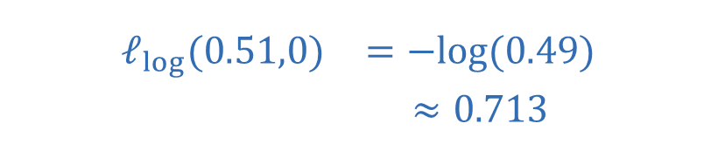
A smooth loss for fitting probabilities
We take the negative logarithm of the probability
assigned to the observed class.
$$ℓ_{log}\left(p,y\right)=\left\{\begin{matrix}−log\left(p\right), & y=1, \\ −log\left(1−p\right), & y=0.\end{matrix}\right.$$
$$ℓ_{log}\left(p,y\right)=−ylog\left(p\right)−\left(1−y\right)log\left(1−p\right)$$
Wrong, but uncertain
Confidently wrong
$$\begin{matrix}ℓ_{log}(0.51,0) & =−log(0.49) \\ & ≈0.713\end{matrix}$$
$$\begin{matrix}ℓ_{log}(0.90,0) & =−log(0.10) \\ & ≈2.303\end{matrix}$$
Logistic loss is also called binary cross-entropy. We use natural logarithms.
Foundations of AI · Lecture 3
15
Notes:
A decreasing function of the probability assigned to the observed class can distinguish predictions that the hard error count treats identically. Choose its negative natural logarithm. If y=1 the observed-class probability is p; if y=0 it is 1-p. Derive the single expression by checking y=0 and y=1. Return to the two wrong predictions with true label 0. At p=.51 the loss is -log(.49)=.7133498879; at p=.90 it is -log(.10)=2.302585093. The uncertain wrong prediction gets a relatively mild penalty, while the confidently wrong prediction gets a much larger one. The smaller loss is not zero: both predictions are wrong. As more probability is assigned to the observed class, the loss decreases smoothly. Logistic loss is also called binary cross-entropy. About 105 seconds.

Slide 16


The empirical logistic loss
The observations stay fixed.
The probability predictions depend on the parameters.
$$p_{i}=p_{θ}\left(x_{i}\right)=σ\left(b+x_{i}w\right)$$
$$ℒ_{log}\left(θ\right)=\sum_{i=1}^{N}{ℓ_{log}\left(p_{θ}\left(x_{i}\right),y_{i}\right)}​$$
We fit this smooth objective,
while the mistake count $ℰ\left(θ\right)$ remains our classification measure.
Foundations of AI · Lecture 3
16
Notes:
Pacing: 0.75 min. Suggested elapsed time 17.25–18 min.
We use a SUM throughout, without1/N. These two objectives evaluate different things. Before differentiating the surrogate, justify its connection to the original classification task.
Reference: Lecture 3, Linear classification, notes version 27 September 2026 (SEMTM0051_week3_classification (13).tex). The planar numerical examples use the synthetic dataset Week_03_classification_distinct.csv, with eta=0.001.

Slide 17
Comparing the two losses
A mistake gives the observed class probability at most 1/2,
so its logistic loss is at least log 2.
Observed label y = 0
Observed label y = 1
$$ℓ_{0,1}\left(\operatorname{step}\left(s\right),y\right)≤\frac{ℓ_{log}\left(σ\left(s\right),y\right)}{log2}$$
Foundations of AI · Lecture 3
17
Notes:
Combine the argument and the plots. If y=1 is misclassified then p<1/2 and -log(p)>log(2). If y=0 is misclassified then 1-p<=1/2 and -log(1-p)>=log(2). For a correct label the zero-one loss is zero and logistic loss is nonnegative. Therefore the rescaled logistic loss bounds zero-one loss pointwise. At s=0, the rescaled logistic loss equals 1 and the tie rule predicts class 1, as the open and closed endpoints show. Add the pointwise inequalities on the next slide. About 90 seconds.

Slide 18
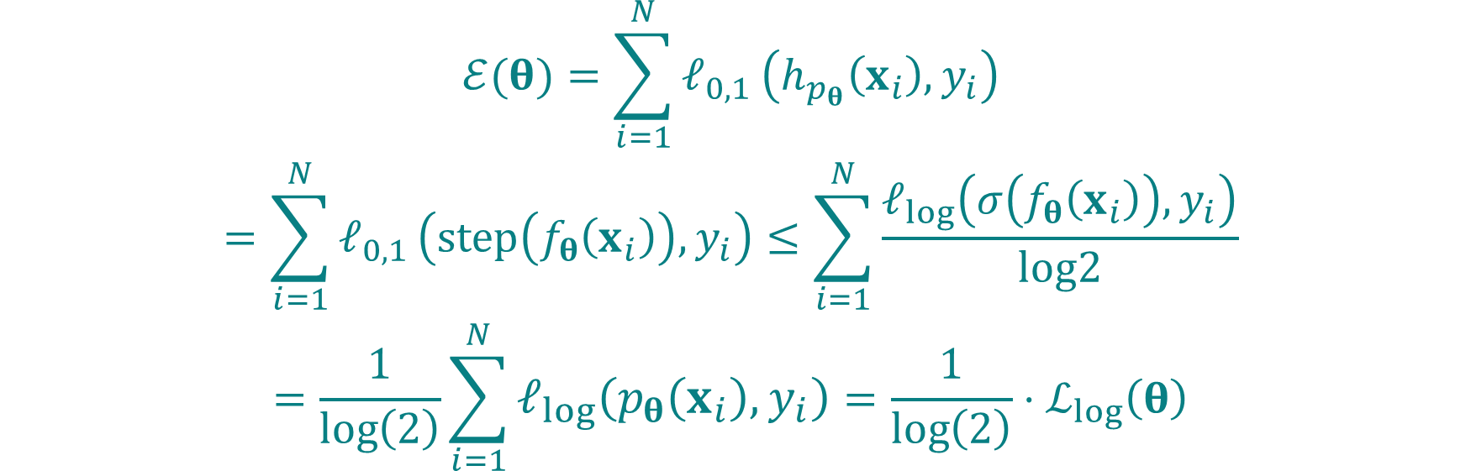
Bounding the number of mistakes
The inequality holds for each observation
We can therefore add it over the dataset
$$\begin{matrix}ℰ(θ)=\sum_{i=1}^{N}{ℓ_{0,1}}\left(h_{p_{θ}}\left(x_{i}\right),y_{i}\right) \\ =\sum_{i=1}^{N}{ℓ_{0,1}}\left(step\left(f_{θ}\left(x_{i}\right)\right),y_{i}\right)≤\sum_{i=1}^{N}{\frac{ℓ_{log}\left(σ\left(f_{θ}\left(x_{i}\right)\right),y_{i}\right)}{log2}} \\ =\frac{1}{\log\left(2\right)}\sum_{i=1}^{N}{ℓ_{log}\left(p_{θ}\left(x_{i}\right),y_{i}\right)}=\frac{1}{\log\left(2\right)}⋅ℒ_{log}\left(θ\right)\end{matrix}$$
A control over the empirical logistic loss gives a control on the number of mistakes
Foundations of AI · Lecture 3
18
Notes:
Sum the pointwise inequality from the preceding slide. The number of mistakes is the unscaled sum of zero-one losses. Substituting the hard classifier keeps the zero-one loss. Only the upper bound uses logistic loss divided by log(2). This gives E(theta)<=L_log(theta)/log(2). The result applies to every parameter choice and every dataset, including the synthetic example used in this presentation.

Slide 19

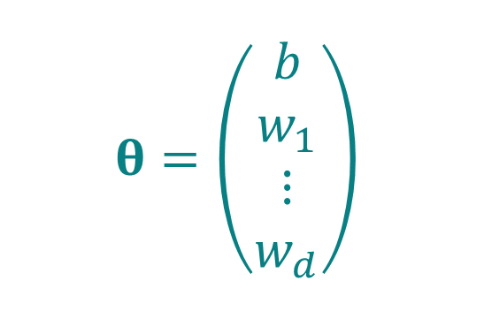
The design matrix and the parameters
As in Lecture 2, a first column of ones includes the intercept.
$$X=\left(\begin{matrix}1 & x_{11} & ⋯ & x_{1d} \\ ⋮ & ⋮ & & ⋮ \\ 1 & x_{N1} & ⋯ & x_{Nd}\end{matrix}\right)$$
$$θ=\left(\begin{matrix}b \\ w_{1} \\ ⋮ \\ w_{d}\end{matrix}\right)$$
$$X∈ℝ^{N×(d+1)}, θ∈ℝ^{(d+1)×1}$$
$$θ_{1}=b, θ_{k+1}=w_{k}, k=1,…,d$$
The first coordinate is the intercept. The remaining coordinates are the weights.
Foundations of AI · Lecture 3
19
Notes:
Before differentiating, organise the inputs and parameters as in Lecture 2. Each row of X is one observation with an initial 1. Write the parameter column explicitly: b, w_1, ..., w_d. The coordinate theta_1 is the intercept; theta_{k+1} is feature weight w_k. X_{i1}=1 and X_{i,k+1}=x_{ik}. This is the general d-feature setting. Source: lecture notes, Writing all observations with one design matrix. About 60 seconds.

Slide 20

The three functions
Fix one input and its observed label. We vary the model parameters.
Affine score
$$F_{i}\left(θ\right)≔f_{θ}\left(x_{i}\right)=b+x_{i}w=\left(1,x_{i}\right)θ=\sum_{r=1}^{d+1}{X_{ir}}θ_{r}$$
Sigmoid
$$σ\left(s\right)=\frac{1}{1+e^{−s}} (s∈ℝ)$$
Logistic loss, with the observed label fixed
$$G_{i}\left(p\right)≔ℓ_{log}\left(p,y_{i}\right)=−y_{i}logp−\left(1−y_{i}\right)log\left(1−p\right)$$
Foundations of AI · Lecture 3
20
Notes:
Fix (x_i,y_i). Name the parameter-to-score function F_i(theta)=f_theta(x_i). The input x_i is fixed and theta varies. Its domain is the parameter space and its output is a real score. Keep the sigmoid name sigma; it maps real scores to probabilities in (0,1). Name the one-variable loss function G_i(p)=ell_log(p,y_i), with y_i held fixed. G_i therefore has one scalar argument and an ordinary derivative G_i prime. These names will let us explicitly identify the composition before applying the chain rule. The affine-score identity (1,x_i)theta follows the user reference slide. About 60 seconds.

Slide 21

The chain rule for one observation
The loss for one observation is the composition of these three functions.
$$ℓ_{log}\left(p_{θ}\left(x_{i}\right),y_{i}\right)=\left(G_{i}∘σ∘F_{i}\right)\left(θ\right)=G_{i}\left(σ\left(F_{i}\left(θ\right)\right)\right)$$
To compute the partial derivatives with respect to $θ_{j}$ of this quantity
We apply the chain rule to this composition.
$$\frac{∂}{∂θ_{j}}\left(G_{i}∘σ∘F_{i}\right)\left(θ\right)=G_{i}^{′}\left(σ\left(F_{i}\left(θ\right)\right)\right)⋅σ^{′}\left(F_{i}\left(θ\right)\right)⋅\frac{∂F_{i}}{∂θ_{j}}\left(θ\right)$$
$$=\underset{first term}{\underbrace{\frac{∂ℓ_{log}}{∂p}\left(σ\left(f_{θ}\left(x_{i}\right)\right),y_{i}\right)}}⋅\underset{second term}{\underbrace{\begin{matrix} \\ \end{matrix}σ^{′}\left(f_{θ}\left(x_{i}\right)\right)\begin{matrix} \\ \end{matrix}}}⋅\underset{third term}{\underbrace{\frac{∂f_{θ}\left(x_{i}\right)}{∂θ_{j}}}}$$
Foundations of AI · Lecture 3
21
Notes:
First show the identity ell_log(p_theta(x_i),y_i)=(G_i composed with sigma composed with F_i)(theta)=G_i(sigma(F_i(theta))). Read the composition from right to left: compute the affine score, then the sigmoid probability, then the loss for the fixed observed label. State that this is the quantity we differentiate, and that we apply the chain rule to this composition. For theta_j, keeping the other parameter coordinates fixed, the named product is G_i prime evaluated at sigma(F_i(theta)), times sigma prime evaluated at F_i(theta), times the partial derivative of F_i with respect to theta_j evaluated at theta. Finally replace the names with their definitions to obtain the full formula in the lecture notes. The three functions and every evaluation point remain explicit. Reveal the composition first, the application statement next, then the named product, then the original-notation product. About 90 seconds.

Slide 22
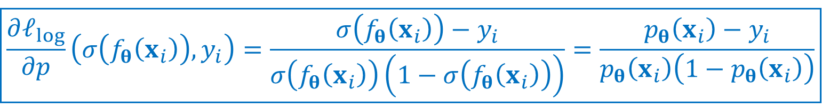

First term: Differentiating the logistic loss
Hold the observed label fixed and vary the probability.
$$ℓ_{log}\left(p,y\right)=−ylogp−\left(1−y\right)log\left(1−p\right)$$
$$\frac{∂ℓ_{log}}{∂p}\left(p,y\right)=−\frac{y}{p}+\frac{1−y}{1−p}=\frac{−y\left(1−p\right)+\left(1−y\right)p}{p\left(1−p\right)}$$
$$=\frac{−y+yp+p−yp}{p\left(1−p\right)}=\frac{p−y}{p\left(1−p\right)}$$
$$\boxed{\frac{∂ℓ_{log}}{∂p}\left(σ\left(f_{θ}\left(x_{i}\right)\right),y_{i}\right)=\frac{σ\left(f_{θ}\left(x_{i}\right)\right)−y_{i}}{σ\left(f_{θ}\left(x_{i}\right)\right)\left(1−σ\left(f_{θ}\left(x_{i}\right)\right)\right)}=\frac{p_{θ}\left(x_{i}\right)−y_{i}}{p_{θ}\left(x_{i}\right)\left(1−p_{θ}\left(x_{i}\right)\right)}}$$
Foundations of AI · Lecture 3
22
Notes:
Pacing: 1.75 min. Suggested elapsed time 25–26.75 min. Differentiating log(1-p) brings a minus sign that cancels the prefactor minus. Use a common denominator p(1-p); +yp and-yp cancel. The result holds for0<p<1. Source derivation is retained as native Office math. Reference: Lecture 3, Linear classification, notes version 27 September 2026 (SEMTM0051_week3_classification (13).tex). The planar numerical examples use the synthetic dataset Week_03_classification_distinct.csv, with eta=0.001.

Slide 23

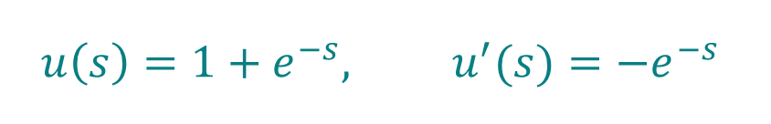
Second term: Differentiating the sigmoid
Write the sigmoid as a composition and apply the chain rule again.
Inner function $u$
Outer function $v$
$$u\left(s\right)=1+e^{−s}, u^{′}(s)=−e^{−s}$$
$$v(z)=\frac{1}{z}, v^{′}(z)=−\frac{1}{z^{2}}$$
$$σ\left(s\right)=\frac{1}{1+e^{−s}}=v\left(u\left(s\right)\right)$$
$$σ^{′}\left(s\right)=v^{′}\left(u\left(s\right)\right) u^{′}\left(s\right)=−\frac{1}{{\left(1+e^{−s}\right)}^{2}}\left(−e^{−s}\right)=\frac{e^{−s}}{(1+e^{−s})^{2}}$$
$$=\frac{1}{1+e^{−s}}⋅\frac{e^{−s}}{1+e^{−s}}=\frac{1}{1+e^{−s}}⋅\left(1−\frac{1}{1+e^{−s}}\right)=σ\left(s\right)\left(1−σ\left(s\right)\right)$$
$$\boxed{σ^{′}\left(f_{θ}\left(x_{i}\right)\right)=σ\left(f_{θ}\left(x_{i}\right)\right)\left(1−σ\left(f_{θ}\left(x_{i}\right)\right)\right)=p_{θ}\left(x_{i}\right)\left(1−p_{θ}\left(x_{i}\right)\right)}$$
Foundations of AI · Lecture 3
23
Notes:
Define the inner function u(s)=1+exp(-s), with derivative u prime(s)=-exp(-s). Define the outer reciprocal function v(z)=1/z for z>0, with derivative v prime(z)=-1/z squared. The value u(s) is greater than 1 for real s, so this composition is well defined. The sigmoid is sigma(s)=v(u(s))=(v composed with u)(s). Apply the chain rule: sigma prime(s)=v prime(u(s))u prime(s). Substitute the two derivatives. The negative signs cancel, yielding exp(-s)/(1+exp(-s)) squared. Factor this as 1/(1+exp(-s)) times exp(-s)/(1+exp(-s)), hence sigma(s)(1-sigma(s)). Finally evaluate at the observation score f_theta(x_i), giving p_theta(x_i)(1-p_theta(x_i)). Reveal composition, chain-rule substitution, simplification, then the observation-specific evaluation. About 90 seconds.

Slide 24


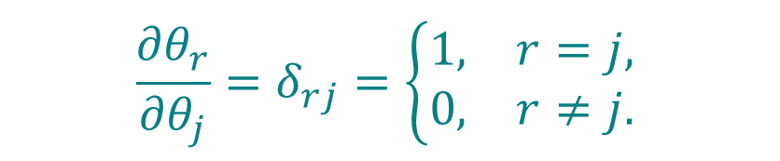
Third term: Differentiating the affine score
The inputs are fixed, so only the matching parameter contributes.
The affine score
The Kronecker delta
$$f_{θ}(x_{i})=\sum_{r=1}^{d+1}{X_{ir}θ_{r}}$$
$$\frac{∂θ_{r}}{∂θ_{j}}=δ_{rj}=\left\{\begin{matrix}1, & r=j, \\ 0, & r≠j.\end{matrix}\right.$$
$$\frac{∂f_{θ}(x_{i})}{∂θ_{j}}=\frac{∂}{∂θ_{j}}\sum_{r=1}^{d+1}{X_{ir}θ_{r}}=\sum_{r=1}^{d+1}{X_{ir}}\frac{∂θ_{r}}{∂θ_{j}}=\sum_{r=1}^{d+1}{X_{ir}δ_{rj}}=X_{ij}$$
$$\boxed{\frac{∂f_{θ}(x_{i})}{∂θ_{j}}=X_{ij}} j=1,…,d+1$$
Foundations of AI · Lecture 3
24
Notes:
This is the third term marked in the chain-rule product. The score is the sum of X_ir theta_r over r=1,...,d+1. Define the Kronecker delta explicitly: delta_rj=1 if r=j and 0 otherwise. Thus partial theta_r / partial theta_j = delta_rj. Differentiate the score sum term by term, keeping every X_ir fixed. The result is the sum of X_ir delta_rj, which selects X_ij. This holds for j=1,...,d+1. For the intercept j=1, X_i1=1; for a feature weight w_k, use j=k+1 and X_i,k+1=x_ik. Source: lecture notes, Writing all observations with one design matrix, equation score-coordinate-derivatives. About 75 seconds.

Slide 25
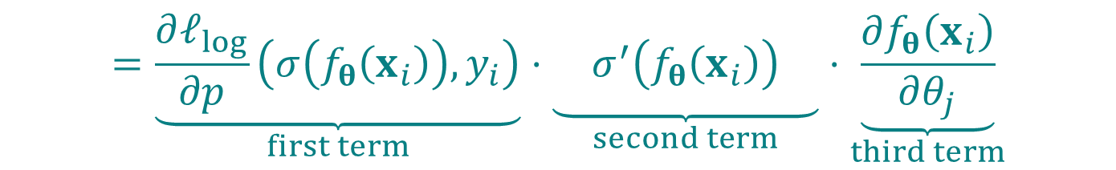
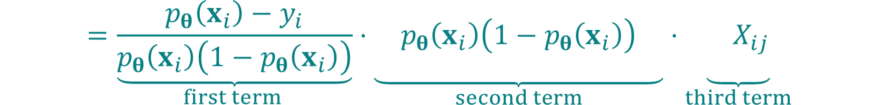
Putting the three terms together
Substitute the first, second and third terms into the chain rule.
$$\frac{∂}{∂θ_{j}}ℓ_{log}\left(p_{θ}\left(x_{i}\right),y_{i}\right)$$
$$=\underset{first term}{\underbrace{\frac{∂ℓ_{log}}{∂p}\left(σ\left(f_{θ}\left(x_{i}\right)\right),y_{i}\right)}}⋅\underset{second term}{\underbrace{\begin{matrix} \\ \end{matrix}σ^{′}\left(f_{θ}\left(x_{i}\right)\right)\begin{matrix} \\ \end{matrix}}}⋅\underset{third term}{\underbrace{\frac{∂f_{θ}\left(x_{i}\right)}{∂θ_{j}}}}$$
$$=\underset{first term }{\underbrace{\frac{p_{θ}\left(x_{i}\right)−y_{i}}{p_{θ}\left(x_{i}\right)\left(1−p_{θ}\left(x_{i}\right)\right)}}}⋅\underset{second term}{\underbrace{\begin{matrix} \\ \begin{aligned} \\ \end{aligned}\end{matrix}p_{θ}\left(x_{i}\right)\left(1−p_{θ}\left(x_{i}\right)\right)\begin{matrix} \\ \begin{aligned} \\ \end{aligned}\end{matrix}}}⋅\underset{third term}{\underbrace{\begin{matrix} \\ \begin{aligned} \\ \end{aligned}\end{matrix}X_{ij}}}$$
$$=(p_{θ}(x_{i})−y_{i})X_{ij}$$
Foundations of AI · Lecture 3
25
Notes:
The three terms have now been derived separately. Substitute the derivative of the logistic loss with respect to probability, the sigmoid derivative evaluated at the score, and the derivative of the affine score. Keep the full probability notation p_theta(x_i). Since this probability is strictly between 0 and 1 for finite parameters, the denominator cancels with the sigmoid derivative. The observation contribution is (p_theta(x_i)-y_i)X_ij. Fitting sigmoid probabilities with logistic loss is called logistic regression. Next, add these derivatives across all observations. Source: lecture notes, Putting the three derivatives together. About 60 seconds.

Slide 26
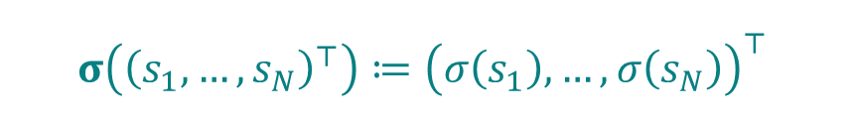

Empirical gradient and gradient descent
The empirical loss is a sum, so we add the observation derivatives.
$$\frac{∂ℒ_{log}}{∂θ_{j}}\left(θ\right)=\sum_{i=1}^{N}{\frac{∂}{∂θ_{j}}ℓ_{log}\left(p_{θ}\left(x_{i}\right),y_{i}\right)}=\sum_{i=1}^{N}{X_{ij}\left(p_{θ}\left(x_{i}\right)−y_{i}\right)}$$
Sigmoid applied to each entry
One probability per observation
$$σ\left({\left(s_{1},…,s_{N}\right)}^{⊤}\right)≔{\left(σ\left(s_{1}\right),…,σ\left(s_{N}\right)\right)}^{⊤}$$
$$p_{θ}≔{\left(p_{θ}\left(x_{1}\right),…,p_{θ}\left(x_{N}\right)\right)}^{⊤}$$
$$p_{θ}=σ\left(Xθ\right), y=(y_{1},…,y_{N})^{T}$$
Gradient
$$∇ℒ_{log}\left(θ\right)=X^{T}\left(p_{θ}−y\right)=X^{T}\left(σ\left(Xθ\right)−y\right)$$
Gradient descent
$$θ^{(t+1)}=θ^{(t)}−η∇ℒ_{log}\left(θ^{\left(t\right)}\right)=θ^{\left(t\right)}−ηX^{T}\left(σ\left(Xθ^{\left(t\right)}\right)−y\right)$$
Foundations of AI · Lecture 3
26
Notes:
First define the bold sigmoid as the function that applies the scalar sigmoid separately to every entry of a score column. Then define bold p with subscript bold theta as the column whose ith entry is the scalar probability p_theta(x_i). These entries refer to different observations; each is the probability assigned to class 1 for that observation. Since X theta is the column of scores, the probability column equals bold sigma(X theta). Define the label column y. Add the per-observation derivatives using the full scalar notation p_theta(x_i), without introducing p_i. The coordinate sums form the gradient X transpose (bold p_theta minus y). Gradient descent uses the probability column evaluated at the current parameter vector theta^(t), then updates all parameter coordinates together. There is no factor 1/N because this empirical loss is a sum. Source: lecture notes, The gradient of the empirical objective and Gradient descent. The probability-vector notation follows the user request: bold p with subscript bold theta. About 100 seconds.

Slide 27

Gradient descent: η = 0.001, t = 0
Initial coefficients:
$$b^{(0)}=−5.75, w_{1}^{(0)}=0, w_{2}^{(0)}=1$$
Learning rate: η = 0.001
Class 1
Class 0
$$x_{2}=5.7500+0.0000x_{1}$$
Logistic loss: 51.048
Mistakes: 31 of 100
Foundations of AI · Lecture 3
27
Notes:
Iteration 0 on the fixed synthetic dataset Week_03_classification_distinct.csv. Parameters: b=-5.750000000000, w1=0.000000000000, w2=1.000000000000. Loss=51.048117252543; mistakes=31 of 100. Initial theta=(-5.75,0,1), learning rate eta=0.001, summed logistic loss with natural logarithms and simultaneous full-batch updates of all three coefficients. Predict class 1 for scores at least zero. No scaling or centring is applied. The same exact CSV coordinates appear at every iteration. The right-hand chart displays logistic loss divided by log(2); the printed numeric loss is unscaled. The boundary equation is rounded to four decimal places; calculations use full precision. At t=0 the coefficients are b=-5.75,w1=0,w2=1 and the boundary is x2=5.75.

Slide 28
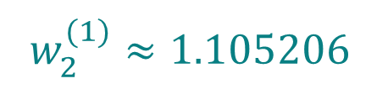
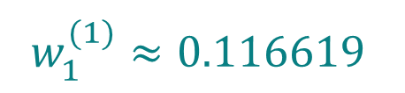
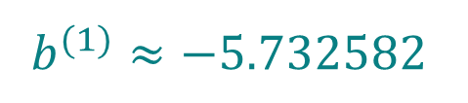

Gradient descent: η = 0.001, t = 1
Coefficients:
$$b^{(1)}≈−5.732582$$
$$w_{1}^{(1)}≈0.116619$$
$$w_{2}^{(1)}≈1.105206$$
Class 1
Class 0
$$x_{2}=5.1869−0.1055x_{1}$$
Logistic loss: 42.733
Mistakes: 15 of 100
Foundations of AI · Lecture 3
28
Notes:
Iteration 1 on the fixed synthetic dataset Week_03_classification_distinct.csv. Parameters: b=-5.732582200752, w1=0.116619209873, w2=1.105205598596. Loss=42.732843717261; mistakes=15 of 100. Initial theta=(-5.75,0,1), learning rate eta=0.001, summed logistic loss with natural logarithms and simultaneous full-batch updates of all three coefficients. Predict class 1 for scores at least zero. No scaling or centring is applied. The same exact CSV coordinates appear at every iteration. The right-hand chart displays logistic loss divided by log(2); the printed numeric loss is unscaled. The boundary equation is rounded to four decimal places; calculations use full precision. At t=0 the coefficients are b=-5.75,w1=0,w2=1 and the boundary is x2=5.75.

Slide 29
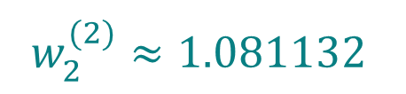
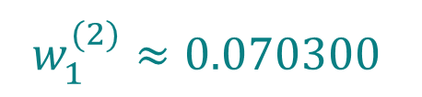
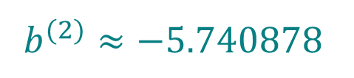

Gradient descent: η = 0.001, t = 2
Coefficients:
$$b^{(2)}≈−5.740878$$
$$w_{1}^{(2)}≈0.070300$$
$$w_{2}^{(2)}≈1.081132$$
Class 1
Class 0
$$x_{2}=5.3101−0.0650x_{1}$$
Logistic loss: 41.668
Mistakes: 7 of 100
Foundations of AI · Lecture 3
29
Notes:
Iteration 2 on the fixed synthetic dataset Week_03_classification_distinct.csv. Parameters: b=-5.740878108919, w1=0.070299523341, w2=1.081132442623. Loss=41.668051132865; mistakes=7 of 100. Initial theta=(-5.75,0,1), learning rate eta=0.001, summed logistic loss with natural logarithms and simultaneous full-batch updates of all three coefficients. Predict class 1 for scores at least zero. No scaling or centring is applied. The same exact CSV coordinates appear at every iteration. The right-hand chart displays logistic loss divided by log(2); the printed numeric loss is unscaled. The boundary equation is rounded to four decimal places; calculations use full precision. At t=0 the coefficients are b=-5.75,w1=0,w2=1 and the boundary is x2=5.75.

Slide 30
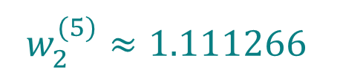
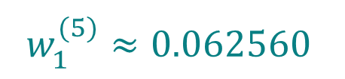
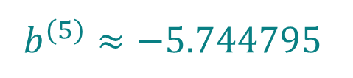

Gradient descent: η = 0.001, t = 5
Coefficients:
$$b^{(5)}≈−5.744795$$
$$w_{1}^{(5)}≈0.062560$$
$$w_{2}^{(5)}≈1.111266$$
Class 1
Class 0
$$x_{2}=5.1696−0.0563x_{1}$$
Logistic loss: 41.300
Mistakes: 8 of 100
Foundations of AI · Lecture 3
30
Notes:
Iteration 5 on the fixed synthetic dataset Week_03_classification_distinct.csv. Parameters: b=-5.744794892947, w1=0.062560462302, w2=1.111266086996. Loss=41.299969095536; mistakes=8 of 100. Initial theta=(-5.75,0,1), learning rate eta=0.001, summed logistic loss with natural logarithms and simultaneous full-batch updates of all three coefficients. Predict class 1 for scores at least zero. No scaling or centring is applied. The same exact CSV coordinates appear at every iteration. The right-hand chart displays logistic loss divided by log(2); the printed numeric loss is unscaled. The boundary equation is rounded to four decimal places; calculations use full precision. At t=0 the coefficients are b=-5.75,w1=0,w2=1 and the boundary is x2=5.75.

Slide 31
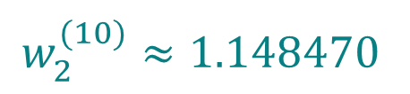
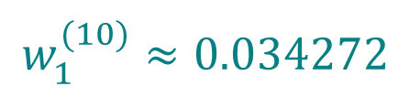
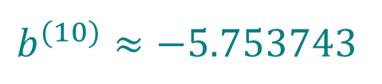

Gradient descent: η = 0.001, t = 10
Coefficients:
$$b^{(10)}≈−5.753743$$
$$w_{1}^{(10)}≈0.034272$$
$$w_{2}^{(10)}≈1.148470$$
Class 1
Class 0
$$x_{2}=5.0099−0.0298x_{1}$$
Logistic loss: 40.848
Mistakes: 8 of 100
Foundations of AI · Lecture 3
31
Notes:
Iteration 10 on the fixed synthetic dataset Week_03_classification_distinct.csv. Parameters: b=-5.753742684547, w1=0.034272137840, w2=1.148469924179. Loss=40.847845820690; mistakes=8 of 100. Initial theta=(-5.75,0,1), learning rate eta=0.001, summed logistic loss with natural logarithms and simultaneous full-batch updates of all three coefficients. Predict class 1 for scores at least zero. No scaling or centring is applied. The same exact CSV coordinates appear at every iteration. The right-hand chart displays logistic loss divided by log(2); the printed numeric loss is unscaled. The boundary equation is rounded to four decimal places; calculations use full precision. At t=0 the coefficients are b=-5.75,w1=0,w2=1 and the boundary is x2=5.75.

Slide 32
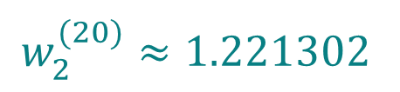
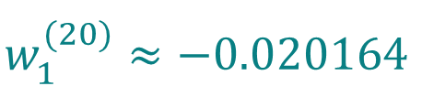
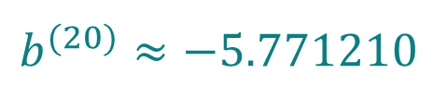

Gradient descent: η = 0.001, t = 20
Coefficients:
$$b^{(20)}≈−5.771210$$
$$w_{1}^{(20)}≈−0.020164$$
$$w_{2}^{(20)}≈1.221302$$
Class 1
Class 0
$$x_{2}=4.7255+0.0165x_{1}$$
Logistic loss: 39.992
Mistakes: 7 of 100
Foundations of AI · Lecture 3
32
Notes:
Iteration 20 on the fixed synthetic dataset Week_03_classification_distinct.csv. Parameters: b=-5.771209836865, w1=-0.020164346945, w2=1.221301838274. Loss=39.992015844938; mistakes=7 of 100. Initial theta=(-5.75,0,1), learning rate eta=0.001, summed logistic loss with natural logarithms and simultaneous full-batch updates of all three coefficients. Predict class 1 for scores at least zero. No scaling or centring is applied. The same exact CSV coordinates appear at every iteration. The right-hand chart displays logistic loss divided by log(2); the printed numeric loss is unscaled. The boundary equation is rounded to four decimal places; calculations use full precision. At t=0 the coefficients are b=-5.75,w1=0,w2=1 and the boundary is x2=5.75.

Slide 33
The loss can fall while mistakes increase
The same planar run shows the limitation of the surrogate.
Step | Logistic loss | Errors
3 | 41.4948 | 7
4 | 41.3932 | 8
The bound still holds at both parameter choices.
Logistic loss can decrease even when the mistake count increases.
Foundations of AI · Lecture 3
33
Notes:
The same synthetic run gives a concrete counterexample at t=3 and t=4. At t=3, loss=41.494823233508 and mistakes=7. At t=4, loss=41.393241660042 and mistakes=8. Thus the summed logistic loss falls while the mistake count increases. The chart shows all iterations 0 through20 and highlights the two table rows. The curve uses loss/log(2), whereas the table uses the unscaled loss. Both parameter choices satisfy the error bound. The twentieth iterate is not claimed to minimize either objective. Data: Week_03_classification_distinct.csv.

Slide 34
Gradient descent: η = 0.002, t = 0
Initial coefficients:
$$b^{(0)}=−5.75, w_{1}^{(0)}=0, w_{2}^{(0)}=1$$
Learning rate: η = 0.002
Class 1
Class 0
$$x_{2}=5.7500+0.0000x_{1}$$
Logistic loss: 51.048
Mistakes: 31 of 100
Foundations of AI · Lecture 3
34
Notes:
Iteration 0 with the larger learning rate eta=0.002. Use the same 100 exact observations from Week_03_classification_distinct.csv and the same initialization theta0=(-5.75,0,1). Full-batch gradient descent with simultaneous updates minimizes the SUM of logistic losses, with natural logarithms and no feature scaling. Current parameters in order b,w1,w2: [-5.75, 0, 1]. Current unscaled logistic loss=51.048117252543; mistakes=31 of100. The right chart displays loss/log(2) and mistakes, using every state from0 through0. The boundary is x2=5.750000000000+0.000000000000*x1. Predict class1 at scores>=0. All six snapshots use common axes, also shared with the smaller-step sequence: x1=[4.5,8], x2=[2,7.5], and loss/count=[0,160]. Displayed coefficients are rounded to six decimals and boundary equations to four; calculations use full precision. Class1 is above the line because w2 remains positive. The final comparison slide follows this six-frame sequence.

Slide 35
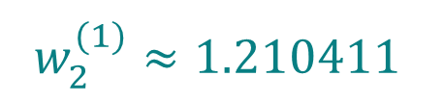
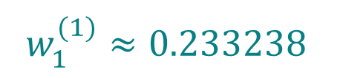
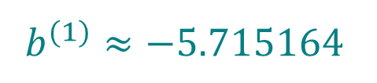

Gradient descent: η = 0.002, t = 1
Coefficients:
$$b^{(1)}≈−5.715164$$
$$w_{1}^{(1)}≈0.233238$$
$$w_{2}^{(1)}≈1.210411$$
Class 1
Class 0
$$x_{2}=4.7217−0.1927x_{1}$$
Logistic loss: 64.556
Mistakes: 42 of 100
Foundations of AI · Lecture 3
35
Notes:
Iteration 1 with the larger learning rate eta=0.002. Use the same 100 exact observations from Week_03_classification_distinct.csv and the same initialization theta0=(-5.75,0,1). Full-batch gradient descent with simultaneous updates minimizes the SUM of logistic losses, with natural logarithms and no feature scaling. Current parameters in order b,w1,w2: [-5.715164401503869, 0.23323841974652645, 1.2104111971912264]. Current unscaled logistic loss=64.556086914804; mistakes=42 of100. The right chart displays loss/log(2) and mistakes, using every state from0 through1. The boundary is x2=4.721671787873-0.192693541077*x1. Predict class1 at scores>=0. All six snapshots use common axes, also shared with the smaller-step sequence: x1=[4.5,8], x2=[2,7.5], and loss/count=[0,160]. Displayed coefficients are rounded to six decimals and boundary equations to four; calculations use full precision. Class1 is above the line because w2 remains positive. The final comparison slide follows this six-frame sequence.

Slide 36
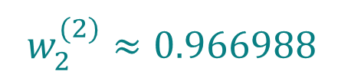
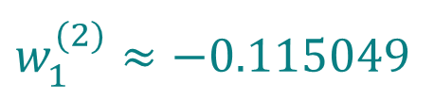
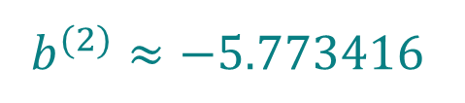

Gradient descent: η = 0.002, t = 2
Coefficients:
$$b^{(2)}≈−5.773416$$
$$w_{1}^{(2)}≈−0.115049$$
$$w_{2}^{(2)}≈0.966988$$
Class 1
Class 0
$$x_{2}=5.9705+0.1190x_{1}$$
Logistic loss: 75.928
Mistakes: 49 of 100
Foundations of AI · Lecture 3
36
Notes:
Iteration 2 with the larger learning rate eta=0.002. Use the same 100 exact observations from Week_03_classification_distinct.csv and the same initialization theta0=(-5.75,0,1). Full-batch gradient descent with simultaneous updates minimizes the SUM of logistic losses, with natural logarithms and no feature scaling. Current parameters in order b,w1,w2: [-5.773416015695164, -0.11504902814070592, 0.9669881153507064]. Current unscaled logistic loss=75.928469389240; mistakes=49 of100. The right chart displays loss/log(2) and mistakes, using every state from0 through2. The boundary is x2=5.970513932947+0.118976672323*x1. Predict class1 at scores>=0. All six snapshots use common axes, also shared with the smaller-step sequence: x1=[4.5,8], x2=[2,7.5], and loss/count=[0,160]. Displayed coefficients are rounded to six decimals and boundary equations to four; calculations use full precision. Class1 is above the line because w2 remains positive. The final comparison slide follows this six-frame sequence.

Slide 37
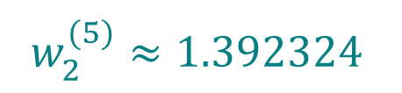
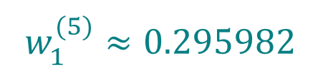
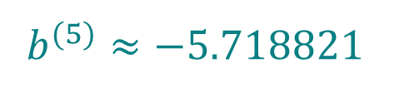

Gradient descent: η = 0.002, t = 5
Coefficients:
$$b^{(5)}≈−5.718821$$
$$w_{1}^{(5)}≈0.295982$$
$$w_{2}^{(5)}≈1.392324$$
Class 1
Class 0
$$x_{2}=4.1074−0.2126x_{1}$$
Logistic loss: 105.343
Mistakes: 49 of 100
Foundations of AI · Lecture 3
37
Notes:
Iteration 5 with the larger learning rate eta=0.002. Use the same 100 exact observations from Week_03_classification_distinct.csv and the same initialization theta0=(-5.75,0,1). Full-batch gradient descent with simultaneous updates minimizes the SUM of logistic losses, with natural logarithms and no feature scaling. Current parameters in order b,w1,w2: [-5.718820554583115, 0.2959820277570571, 1.3923239884245995]. Current unscaled logistic loss=105.343291649936; mistakes=49 of100. The right chart displays loss/log(2) and mistakes, using every state from0 through5. The boundary is x2=4.107392102792-0.212581288707*x1. Predict class1 at scores>=0. All six snapshots use common axes, also shared with the smaller-step sequence: x1=[4.5,8], x2=[2,7.5], and loss/count=[0,160]. Displayed coefficients are rounded to six decimals and boundary equations to four; calculations use full precision. Class1 is above the line because w2 remains positive. The final comparison slide follows this six-frame sequence.

Slide 38
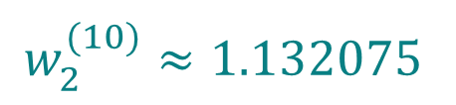
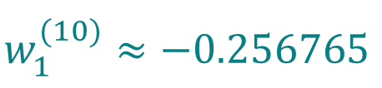
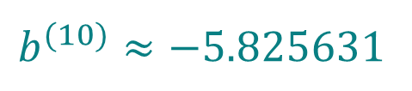

Gradient descent: η = 0.002, t = 10
Coefficients:
$$b^{(10)}≈−5.825631$$
$$w_{1}^{(10)}≈−0.256765$$
$$w_{2}^{(10)}≈1.132075$$
Class 1
Class 0
$$x_{2}=5.1460+0.2268x_{1}$$
Logistic loss: 77.632
Mistakes: 49 of 100
Foundations of AI · Lecture 3
38
Notes:
Iteration 10 with the larger learning rate eta=0.002. Use the same 100 exact observations from Week_03_classification_distinct.csv and the same initialization theta0=(-5.75,0,1). Full-batch gradient descent with simultaneous updates minimizes the SUM of logistic losses, with natural logarithms and no feature scaling. Current parameters in order b,w1,w2: [-5.825631064207245, -0.25676501599138746, 1.1320747188876807]. Current unscaled logistic loss=77.631925322662; mistakes=49 of100. The right chart displays loss/log(2) and mistakes, using every state from0 through10. The boundary is x2=5.145977528702+0.226809248283*x1. Predict class1 at scores>=0. All six snapshots use common axes, also shared with the smaller-step sequence: x1=[4.5,8], x2=[2,7.5], and loss/count=[0,160]. Displayed coefficients are rounded to six decimals and boundary equations to four; calculations use full precision. Class1 is above the line because w2 remains positive. The final comparison slide follows this six-frame sequence.

Slide 39
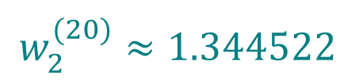
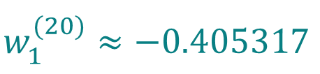
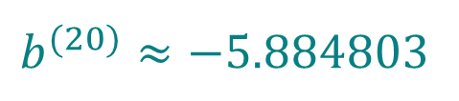

Gradient descent: η = 0.002, t = 20
Coefficients:
$$b^{(20)}≈−5.884803$$
$$w_{1}^{(20)}≈−0.405317$$
$$w_{2}^{(20)}≈1.344522$$
Class 1
Class 0
$$x_{2}=4.3769+0.3015x_{1}$$
Logistic loss: 72.282
Mistakes: 48 of 100
Foundations of AI · Lecture 3
39
Notes:
Iteration 20 with the larger learning rate eta=0.002. Use the same 100 exact observations from Week_03_classification_distinct.csv and the same initialization theta0=(-5.75,0,1). Full-batch gradient descent with simultaneous updates minimizes the SUM of logistic losses, with natural logarithms and no feature scaling. Current parameters in order b,w1,w2: [-5.8848028169142435, -0.40531673157394843, 1.3445218616961205]. Current unscaled logistic loss=72.281826821169; mistakes=48 of100. The right chart displays loss/log(2) and mistakes, using every state from0 through20. The boundary is x2=4.376874028281+0.301457896016*x1. Predict class1 at scores>=0. All six snapshots use common axes, also shared with the smaller-step sequence: x1=[4.5,8], x2=[2,7.5], and loss/count=[0,160]. Displayed coefficients are rounded to six decimals and boundary equations to four; calculations use full precision. Class1 is above the line because w2 remains positive. The final comparison slide follows this six-frame sequence.

Slide 40
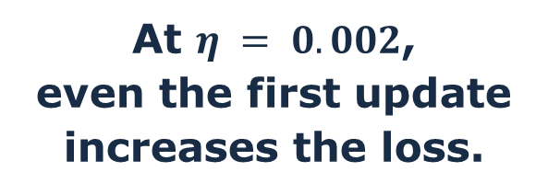

Step size and logistic loss
Same data and initial coefficients; only the learning rate changes.
Step | Loss $$η=0.001$$ | Loss $$η=0.002$$
0 | 51.048 | 51.048
1 | 42.733 | 64.556
At $η = 0.002$,
even the first update
increases the loss.
A step that is too large can increase the loss.
Foundations of AI · Lecture 3
40
Notes:
Repeat full-batch gradient descent on Week_03_classification_distinct.csv from theta0=(-5.75,0,1). Compare eta=0.001 with eta=0.002 using the SUM of logistic losses and natural logarithms, no scaling, and simultaneous updates. Both histories contain all iterations 0 through 20. The chart and table show unscaled logistic loss, not loss/log(2). For eta=0.001, loss decreases from 51.048117252543 to 39.992015844938. For eta=0.002, the first update increases loss from 51.048117252543 to 64.556086914804; subsequent values oscillate. The finite plot does not establish divergence. At a point with nonzero gradient, minus the gradient is a direction of local decrease: sufficiently small positive steps decrease the loss. A step that is too large can increase the loss. The objective remains the same convex logistic loss; changing only the learning rate explains the difference. The companion step-size CSV contains all coefficients, gradients, losses and error counts for both runs. The earlier sequence and its parameters remain unchanged.

Slide 41



More than two classes
Recognising a handwritten digit means choosing among ten classes: $0, 1, …, 9$.
An image is made of pixels.
In greyscale, their intensities
form a matrix of real numbers.
We read the matrix row by row
to form a row vector.
We use the same pixel order
for every image.
$$x=(x_{1},…,x_{d})∈ℝ^{1×d}$$
Here, $d$ is the number of pixels.
Each row contains examples of the same digit.
We predict one probability per class and choose the most probable label.
Foundations of AI · Lecture 3
41
Notes:
Handwritten-digit recognition motivates multiclass classification. Each image belongs to one of the ten digit classes 0 through 9. Within a class, handwriting varies. We want one probability per class, then choose the largest. Source: supplied lecture notes, Week_03 - Linear Classification.pdf, Figure 8, page 19. Figure reproduced directly from the original PDF. Each row contains 16 examples of the same digit. The image is now represented as a row vector before introducing the model.
Input representation: a greyscale image is a matrix of pixel intensities, represented numerically by real values. Read its entries row by row in the same fixed order for every image to form a row vector x=(x_1,...,x_d). Here d is the number of pixels, and each coordinate contains one pixel intensity. No intensity range or normalization convention is assumed on this slide. The next slide denotes the row vector of observation i by x_i in bold; the subscripts of the scalar coordinates on this slide index pixels.

Slide 42

Predicting class probabilities
A probabilistic predictor assigns one probability to each possible class $\left\{1,…,K\right\}$.
$$p:ℝ^{1×d}⟶{\left[0,1\right]}^{1×K}$$
$$p\left(x\right)=\left(p_{1}\left(x\right),…,p_{K}\left(x\right)\right)$$
Each component gives the predicted probability of the corresponding class.
For this vector to represent a valid probability distribution,
we require its components to sum to one:
$$\sum_{k=1}^{K}{p_{k}}(x)=1$$
If we must choose one label, which should we predict?
Foundations of AI · Lecture 3
42
Notes:
Start with a general probabilistic predictor, before choosing any parametric model. K is the number of classes and d is the number of input features. Label the classes 1,...,K. The K components are predicted probabilities, each between zero and one, and sum to one. In the digit example the ten indices stand for digits 0,...,9. This is a row-valued function. It parallels the binary probability predictor, where one scalar determines both probabilities.

Slide 43

The multiclass plug-in rule
Choose the class with the largest predicted probability.
$$h_{p}:ℝ^{1×d}⟶\{1,…,K\}$$
$$h_{p}(x)=\max\left({argmax}_{k∈\left\{1,…,K\right\}}{p_{k}\left(x\right)}\right)$$
$argmax⁡⁡$ returns the set of indices of the largest components.
The outer $max⁡$ chooses the largest index (in case of a tie).
$$p\left(x\right)=\left(0.25,0.2,0.12,0.18,0.25\right)$$
$$⟹{argmax}_{k∈\left\{1,…,5\right\}}{p_{k}\left(x\right)}=\left\{1,5\right\}$$
$$⟹h_{p}\left(x\right)=\max\left\{1,5\right\}=5$$
The largest probability need not exceed one half.
How do we build the probability function?
Foundations of AI · Lecture 3
43
Notes:
The plug-in classification rule turns any probability row into a label. Argmax returns all indices attaining the largest component. We choose the largest index in a tie, consistently with the binary convention. This is argmax, not softmax: softmax will later construct a probability row from scores. In the example (0.40,0.35,0.25), class1 is predicted although no probability exceeds one half. If probabilities are(0.40,0.40,0.20), the convention predicts2.

Slide 44


One affine score per class
As in binary classification, these affine scores are also called logits.
for each class $k=1,…,K$
$$b_{k}∈ℝ, w_{k}=\left(\begin{matrix}w_{1k} \\ ⋮ \\ w_{dk}\end{matrix}\right)∈ℝ^{d×1}$$
$$θ_{k}=\left(\begin{matrix}b_{k} \\ w_{k}\end{matrix}\right)∈ℝ^{(d+1)×1}$$
The $k$-th score function is defined via
$$f_{θ_{k}}(x)=b_{k}+xw_{k}=(1,x)θ_{k}$$
Stack all the parameter columns in a matrix $Θ$
$$Θ=\left(\begin{matrix}θ_{1} & ⋯ & θ_{K}\end{matrix}\right)∈ℝ^{\left(d+1\right)×K}$$
$$f_{Θ}\left(x\right)=\left(f_{θ_{1}}\left(x\right),…,f_{θ_{K}}\left(x\right)\right)=\left(1,x\right)Θ∈ℝ^{1×K}$$
Foundations of AI · Lecture 3
44
Notes:
For each class k=1,...,K, define the scalar intercept b_k and column w_k of d feature weights. Weight w_jk belongs to feature j and class k. Stack the intercept and weights in theta_k. The augmented input row (1,x) has d+1 entries, so its product with theta_k is one real score. Collect the K columns in Theta, of shape(d+1)byK. The row f_Theta(x) contains the K scores and equals(1,x)Theta. All required symbols are defined here. Batch matrix X is not needed in this single-input construction or the later summed loss.

Slide 45
Softmax turns scores into probabilities
Exponentiate each score, then divide by the sum across classes.
$$s=(s_{1},…,s_{K})∈ℝ^{1×K}$$
$$softmax:ℝ^{1×K}⟶(0,1)^{1×K}$$
$$[softmax(s)]_{k}=\frac{e^{s_{k}}}{\sum_{r=1}^{K}{e^{s_{r}}}}, k=1,…,K$$
$$[softmax(s)]_{k}>0$$
$$\sum_{k=1}^{K}{[}softmax(s)]_{k}=\frac{\sum_{k=1}^{K}{e^{s_{k}}}}{\sum_{r=1}^{K}{e^{s_{r}}}}=1$$
Warning: separate sigmoids do not ensure a sum of one!!!
Three zero scores would give three probabilities of one half.
Foundations of AI · Lecture 3
45
Notes:
Define softmax first as a map on an arbitrary row of real scores. All exponentials are positive, and dividing by their sum makes the output components sum to one. For K>=2 the components lie strictly between0and1. Use square brackets to denote a component of the softmax row. Separate sigmoids do not impose the sum-one constraint: three zero scores yield three one-half values.

Slide 46

Our multiclass probability model
Apply softmax to the row of affine scores.
$$p_{Θ}\left(x\right)=softmax\left(f_{Θ}\left(x\right)\right)$$
Its component for each class is
$$p_{Θ,k}\left(x\right)≔{\left[p_{Θ}\left(x\right)\right]}_{k}=\frac{exp\left(f_{θ_{k}}(x)\right)}{\sum_{r=1}^{K}{exp}\left(f_{θ_{r}}(x)\right)}, k=1,…,K$$
Apply the same plug-in rule to these probabilities.
$$h_{p_{Θ}}(x)=\max\left({argmax}_{k∈\left\{1,…,K\right\}}{p_{Θ,k}\left(x\right)}\right)$$
The largest score and largest probability identify the same class.
Foundations of AI · Lecture 3
46
Notes:
The parametric probability predictor is p_Theta(x)=softmax(f_Theta(x)). Its kth component is exp(f_theta_k(x)) divided by the sum of those exponentials over all classes. Only now do we introduce p_Theta; all its constituent functions and parameters have already been defined. Reuse the generic plug-in rule with p=p_Theta. The exponential is increasing and every component has the same positive denominator, so maximizers of scores and probabilities coincide, including ties. The largest-index tie convention remains in force.

Slide 47
An example with three classes
Fix one input and suppose its three affine scores are as follows.
$$f_{Θ}(x)=(0,log2,log3)$$
$$(e^{0},e^{log2},e^{log3})=(1,2,3)$$
$$p_{Θ}(x)=\left(\frac{1}{1+2+3},\frac{2}{1+2+3},\frac{3}{1+2+3}\right)=\left(\frac{1}{6},\frac{1}{3},\frac{1}{2}\right)$$
$$h_{p_{Θ}}\left(x\right)=\max\left({argmax}_{k∈\left\{1,2,3\right\}}{p_{Θ,k}\left(x\right)}\right)=\max\left(\left\{3\right\}\right)=3$$
Class 3 has the largest predicted probability.
Foundations of AI · Lecture 3
47
Notes:
For a fixed input x and parameter matrix Theta, the score row is(0,log2,log3). Natural logarithms give exponentials1,2,3. Their sum is6, so the class probabilities are(1/6,1/3,1/2). The plug-in classifier predicts class3. This uses the generic rule already defined; it does not introduce a second decision rule. The next slide keeps these probabilities but supposes that the observed class is2.

Slide 48
Cross-entropy loss for the observed class
For a probability row and an observed class, use the probability of that class.
$$p=(p_{1},…,p_{K}), y∈\{1,…,K\}, p_{y}>0$$
$$ℓ_{multi}\left(p,y\right)=−log\left(p_{y}\right)$$
$$p=\left(\frac{1}{6},\frac{1}{3},\frac{1}{2}\right), y=2$$
$$ℓ_{multi}(p,2)=−log\left(1/3\right)=log\left(3\right)$$
Using the plug-in rule, the prediction is class 3, but the observed class is 2.
The loss uses the probability assigned to class 2.
Foundations of AI · Lecture 3
48
Notes:
For a probability row p and observed class y, categorical cross-entropy is minus the logarithm of p_y. The softmax model assigns strictly positive probabilities, so this is finite. If one extends the loss to general probability rows, a zero probability for the observed class gives infinite loss. With(1/6,1/3,1/2)and observed class2, the plug-in prediction is3 but the loss is-log(1/3)=log3. The observed class determines which probability enters the loss. Use natural logarithms and the lecture notes notation ell_multi.

Slide 49

The multiclass fitting objective
For $N$ labelled observations, add the individual losses.
$$(x_{i},y_{i}), i=1,…,N, x_{i}∈ℝ^{1×d}, y_{i}∈\{1,…,K\}$$
$$ℒ_{multi}\left(Θ\right)=\sum_{i=1}^{N}{ℓ_{multi}\left(p_{Θ}\left(x_{i}\right),y_{i}\right)}$$
Fit the parameter matrix by minimising this summed loss,
e.g., via gradient descent.
Foundations of AI · Lecture 3
49
Notes:
There are N labelled observations(x_i,y_i), with each input a row of d features and each label one of1,...,K. Define the empirical objective as the SUM, not mean, of individual categorical cross-entropies. Its equivalent component form is minus the sum of log p_{Theta,y_i}(x_i). For one observation, let s=f_Theta(x); substituting softmax in the individual loss yields -s_y+log(sum exp(s_k)). Fit Theta by minimizing the sum. No multiclass gradient derivation is included, consistently with the lecture notes.

Slide 50

Models and fitting losses
Binary and multiclass models turn affine scores into class probabilities.
Task | Model predictions | Fitting loss
Regression | Numerical values | Squared loss
Binary classification | Sigmoid probabilities | Logistic loss
Multiclass classification | Softmax probabilities | Cross-entropy loss
We fit probabilities with a smooth loss.
We evaluate classification by counting mistakes.
Lecture notes and exercises explain the material in more detail.
Exercise solutions will be posted before the next lecture.
github.com/semtm0051/2026_27
Foundations of AI · Lecture 3
50
Notes:
Recap the parallel with regression: the model predicts a numerical value or class probabilities, and we fit an appropriate smooth loss. For classification, evaluation still counts mistakes. Direct students to the notes and exercises via the link or QR code. Solutions will be posted before the next lecture. About one minute.

